Slide 1

DriverPass System Analysis
Thomas Cheek
Notes:
[No speaker notes required for this slide.]

Slide 2

System Requirements
Functional Requirements:
The system shall allow students to schedule on-the-road driving lessons and modify their appointments online.
The system shall provide students with practice exams and immediate feedback on their performance.
Nonfunctional Requirements:
The system must support 500 simultaneous users without performance degradation.
The system must encrypt all sensitive data exchanges using TLS 1.2 or higher to ensure security.
Notes:
[In your speaker notes, include an explanation of the different requirements you determined for DriverPass’s system. What are the functional requirements you selected to describe? What are the nonfunctional requirements you selected to describe? Be sure to explain how these requirements meet DriverPass’s needs.]

Slide 3
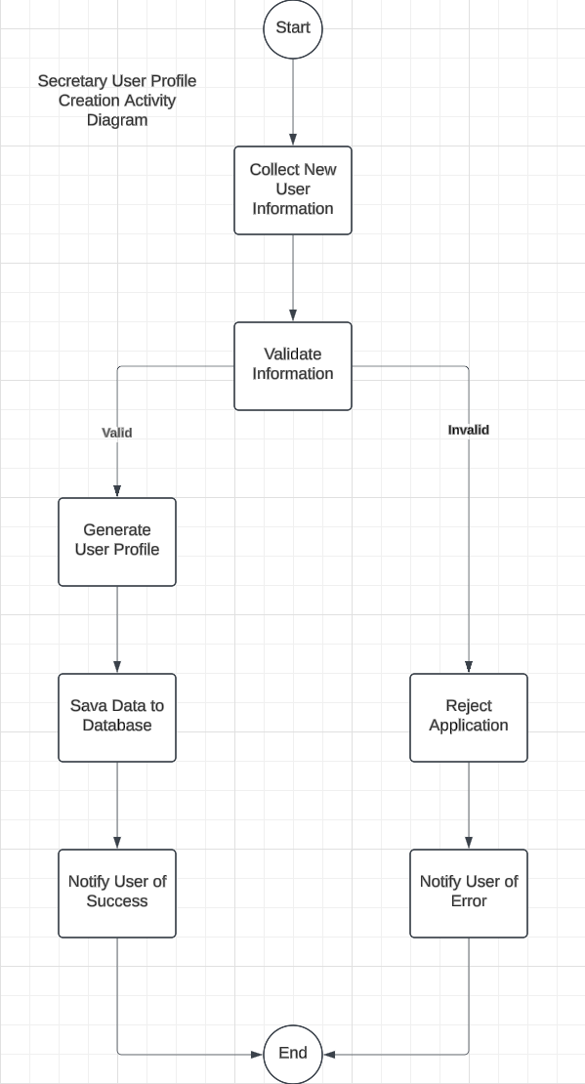
Use Case Diagram
Notes:
This diagram represents the steps involved in registering a DriverPass user. It begins with collecting user information, followed by validating the data. If the information is valid, a DriverPass profile is generated, saved to the database, and the user is notified. If the data is invalid, the registration is rejected, and an error notification is sent to the user. The diagram outlines decision points (valid or invalid information) and key system actions.

Slide 4
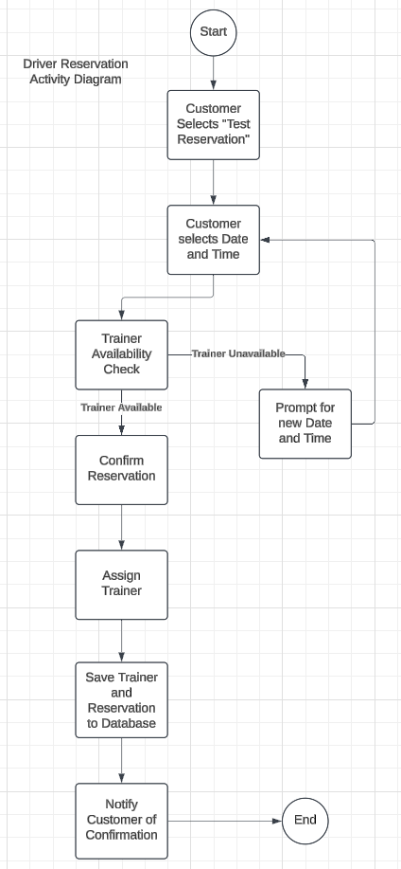
Activity Diagram
Notes:
This diagram illustrates how a customer makes a reservation for driving lessons. It starts with the customer selecting a package and choosing a date and time. The system checks the availability of trainers and cars. If available, the reservation is confirmed, saved to the database, and the user is notified. If unavailable, the system prompts the customer to try again. It clearly maps the flow of actions and decision points.

Slide 5
Security
Multi-factor authentication for all user accounts.
01
Encrypted storage of sensitive user data using AES-256.
02
Secure communication protocols using TLS 1.2 or higher.
03
Role-based access control to limit user permissions (e.g., students, instructors, administrators).
04
Regular audits and logging to monitor system activity for suspicious behavior.
05
Notes:
Account Protection: While the process is not depicted in this presentation, every user’s account is safeguarded by a two-step login process. This adds an extra layer of protection, ensuring that even if someone’s password is guessed, their account remains secure.
Data Safety: All personal information, like contact details and lesson schedules, is scrambled during transfer, making it unreadable to anyone trying to intercept it. Add
Access Control: Each user has specific permissions based on their role. For example, students can only view their lessons and exams, while instructors can see their schedules and notes but not student details beyond what’s necessary.

Slide 6
System Limitations
On-the-road training is limited to available instructors and vehicles.
The system will initially rely on manual updates for DMV compliance changes.
Notes:
Manual Updates: Any changes to driving test requirements or new regulations will need to be added manually for now
Instructor Availability: On-the-road training sessions depend on the availability of instructors and vehicles. Scheduling may become limited during busy times.
Budget Constraints: To keep costs manageable, some advanced features, like automatic lesson reminders or personalized study plans, will not be available at launch. These can be added in later phases.

